Slide 1
Git and GitHub
Bootcamp session by John Harvey

Slide 3
Getting and updating a Repo
git clone <repo address> - downloads repo
https://github.com/john681611/BootcampGIT
git pull origin <branch> - pulls a branch from remote
git fetch – updates your local git with branches

Slide 4
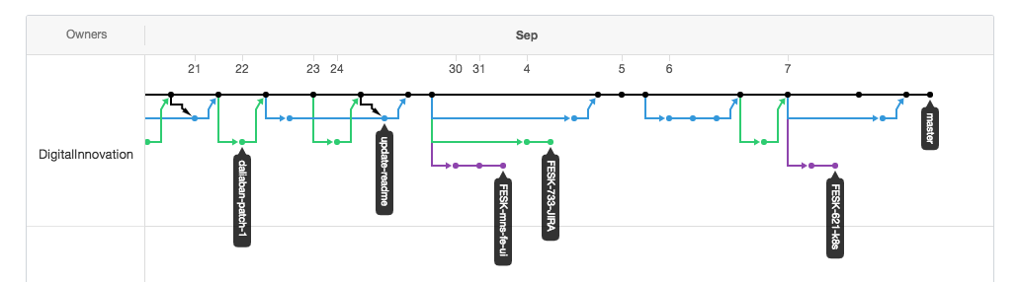
Branching & Forks
Branches are part of the same repo, forks are a linked copy of the original repo.
git checkout <branch> - check out local or remote branch
git checkout -b <newBranch>

Slide 5
Committing changes and pushing to remote
git status – what has changed
git diff – shows differences in your changes
git add <directory or file> - stage changes to be committed
git commit –m ”<commit Message>” – commit a message locally
git log - shows commit log
git push origin <branch> - push local commits to remote

Slide 6
Merging and Rebasing
Generally brings together branches. Bringing changes from your selected branch to your checked out branch.
git merge <from branch> - merge branches commit changes
git rebase <from branch> - replays history to put your commits after the current head
git rebase –i <from branch> - interactive mode that allows you to modify commits.
Rebase Exercise - https://github.com/DigitalInnovation/git-rebase-exercise

Slide 7
SSH Keys making life easier
Github Tutorial

